Slide 1
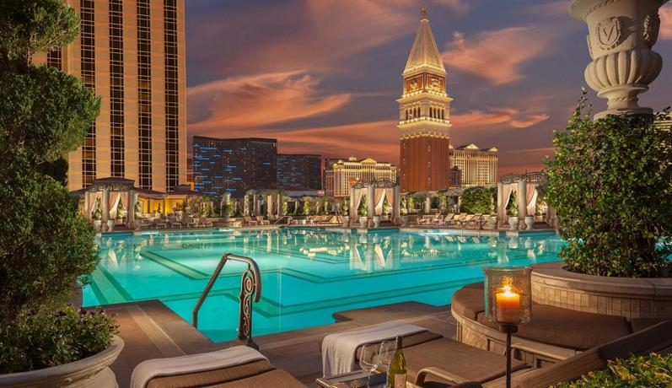
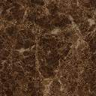

My hotel
prediction
Yarin Shlomo 316164060
Daniel Rokach 312324940
Shelly Itzhar 318685989
data mining and machine learning final project

Slide 2
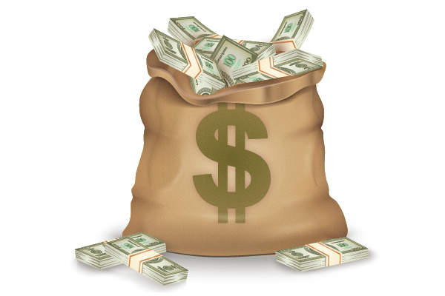

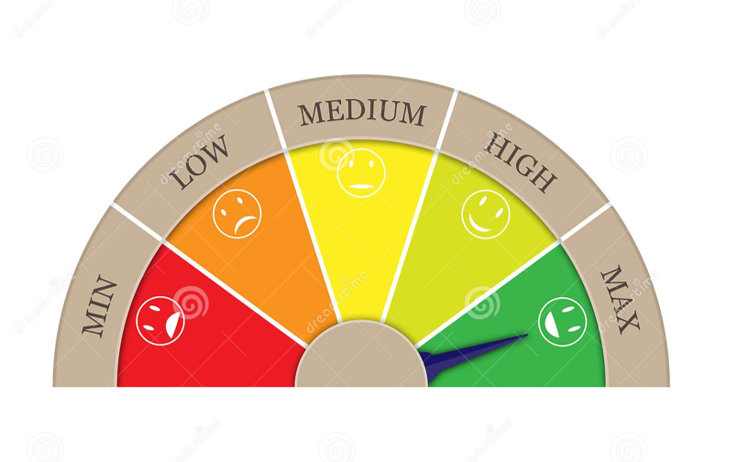
Our research - intro
1. Predict price range of a hotel according to it's features
2. Predict number of stars of the hotel according to it's features
3. Predict the hotel's visitors overall rating according to it's features

Slide 3

Data sources
Crawling
Booking

Slide 4
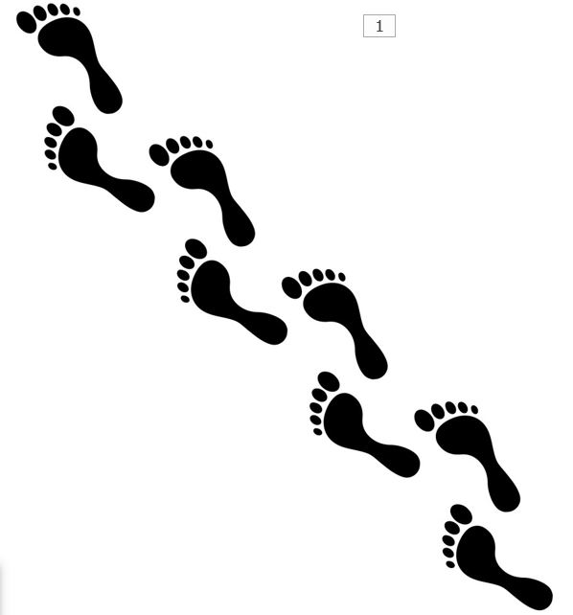
Crawling
Step 1 –
Extract the following cities URLs from booking while filtering only hotels:
Budapest
Bucharest
Istanbul
London
Moscow
Paris
Rome
Seoul
Singapore
Tokyo
Tel - Aviv
Athens
Barcelona
After the process, we assigned all the URLs to correspondent variables.

Slide 5
Crawling
Step 2 –
Extract the following hotels information from each personal page using BeautifulSoup and Selenium.
Name - The hotel name.
Price - The hotel price per night in ILS.
Rating - The overall rating the visitors gave the hotel.
Stars - The amount of stars the hotel has.
Reviews - The number of reviews the hotel got from visitors.
Categorical visitor score - Location, Cleanliness, Staff, Comfort, Value for money, Facilities and Wi-Fi.
Nearby - Closest attraction, Closest Transportation and Closest airport.
Number of payments methods - The number of payment methods the hotel suggest.
Number of languages - The number of languages that are spoken by the hotel staff.
Allowing pets - True or False value about the permission of pets in the hotel grounds.
Step 3 –
Save all the information we found using crawling to a csv file.

Slide 6
Data Cleaning And Manipulation
When handling the data we had to deal with missing data and also with data that had to be manipulated to suit our needs.
Data manipulation
* We removed the word 'Hotel' from the hotels we got because some hotel's names started with it and some were not.
* Some hotels didn't have the section of 'Closest transportation' because they were not close to any transportation. We placed the highest value possible for those.
* For the last step, we removed the ',' from the prices and reviews with more than 3 digits so we will be able to covert those to float.

Slide 7
Data Cleaning And Manipulation
Data cleaning
* We started by removing all the duplicated rows.
* We removed all the hotels with 0 stars. Booking made it hard to get the hotel's stars so some info was missing.
* We removed every row with even 1 missing value in it.
* For the same reason as why we couldn't get the amount of stars of each hotel, we also couldn't get all the ratings of the hotels and got the word 'Read' instead. We had to get rid of those.

Slide 8
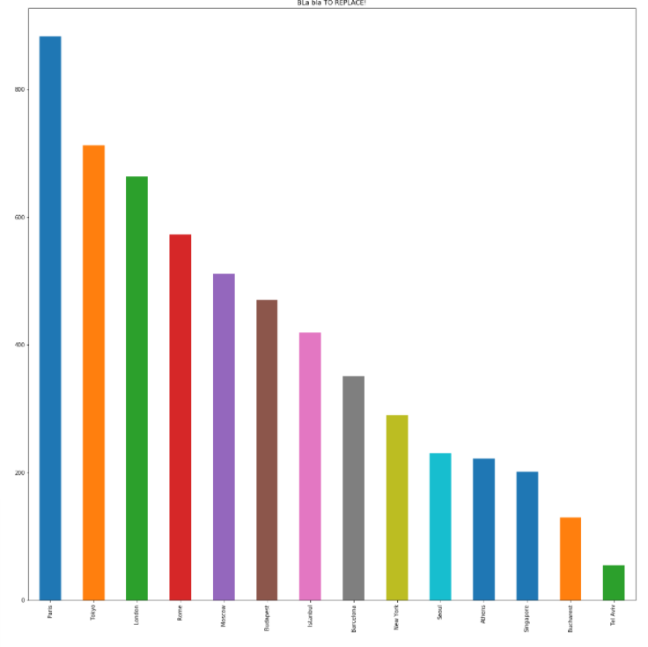
visualization
General information about the amount of hotels in each city we examined.

Slide 9
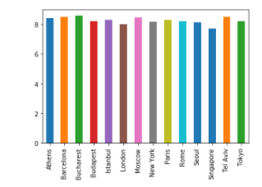
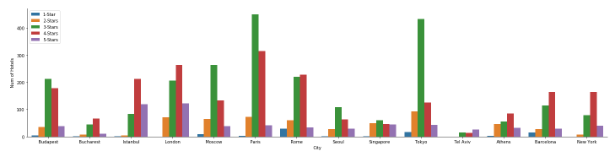
visualization
As we can see from both graphs above, despite the difference in the hotels stars ratio between the cities, the visitor's rating is almost identical.

Slide 10
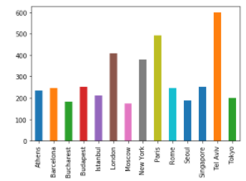
visualization
As we can see, although
some cities considered expensive (Tokyo, London, etc.), their hotel prices remains rationally the same as other cities. Also, our finding support the claim that Tel Aviv is the most expensive city in the world.

Slide 11
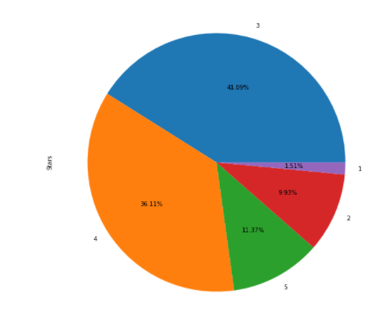
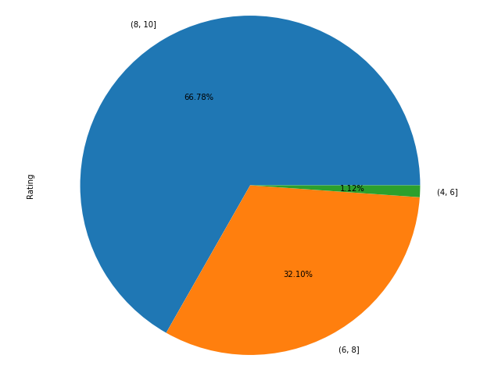
visualization
As we can see, Although most of the hotels are 3 stars and below, most of the rating scores are between 8 and 10.

Slide 12
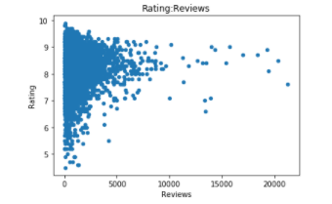
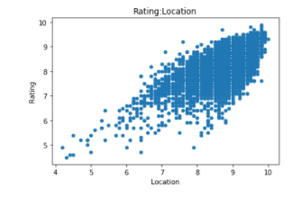
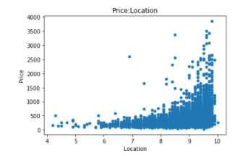
visualization
As we can see, people were more inclined to rate the hotel when they had a good time.
As we can see, there is direct connection between the location score to the overall rating.
As we can see, whenever the location score is relatively low the price will be accordingly low. additionally the location score is high it's price is roughly up to doubled on most cases.

Slide 13
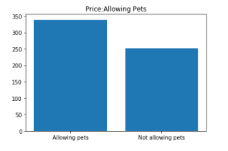
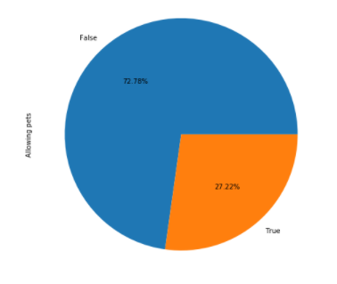
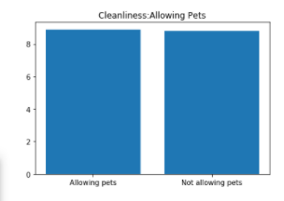
visualization
As we can clearly see, the hotels that allowing pets inside them are more expensive than the others but it seems like there is a reason for the price, those hotels are as clean as hotels that are not allowing pets.

Slide 14
Machine Learning
We used three different labels for 2 different machine learning algorithms. The labels are- 'Price', 'Rating' and 'stars'.
Price:
Predicting the price of the hotel didn't give us good results so we instead divided the prices to bins and predicted the price bin that a hotel will be in. We used Linear Regression.
Before we divided to beans we got accuracy of 50% and after we got accuracy of 75%.
Rating:
When predicting the rating of the hotel we used Logistic Regression. The final accuracy is 97%.
Stars:
When predicting the stars amount of the hotel we used Linear Regression because stars is a categorical label.
The final model accuracy is 72%.

Slide 15
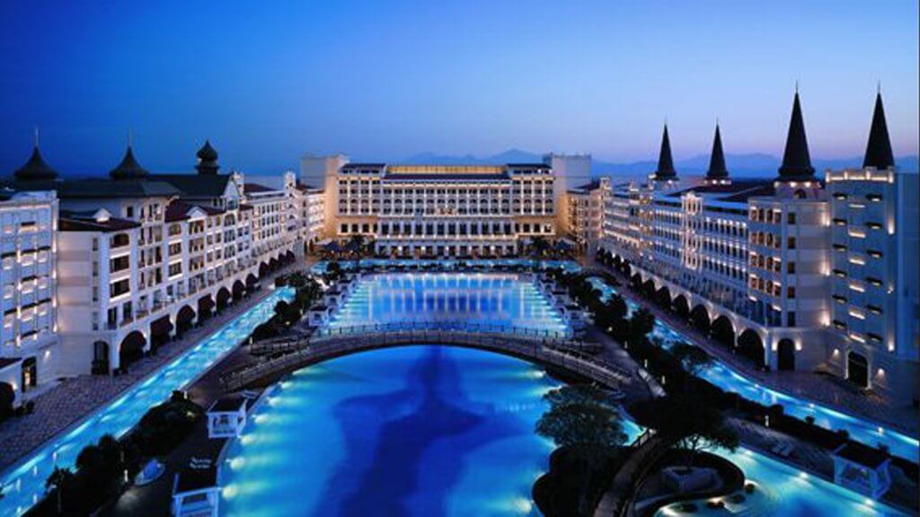
THE END

